Slide 1
BLG 102 E Extra Practice
Sunday, May 31, 2020

Slide 2
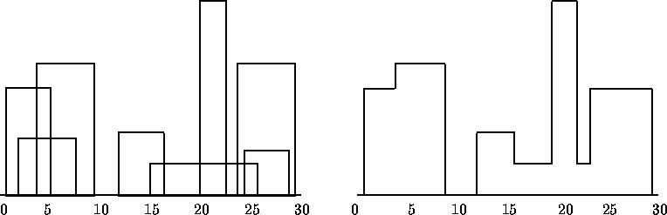
The Skyline Problem
Given:
Starting coordinate
Width
Height
of a set of buildings, find the skyline.
Find the silhouette that the overlapping buildings form.

Slide 3
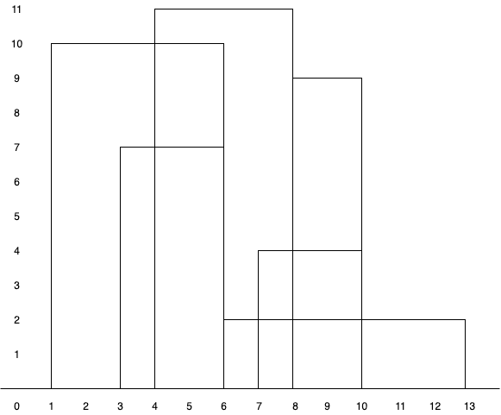
The Skyline Problem
You will be given a “buildings.txt” file:
Starting Position Width Height
1 5 10
3 3 7
4 4 11
6 7 2
7 3 4
8 2 9

Slide 4
The Skyline Problem
Write a program that:
Accepts a building file name as an input argument.
Reads the building information from the file
Prints out the skyline
Numerically
Visually?

Slide 5
Gradebook
Students: Name & Number
Gradebook: Students (Max 10) & Current # of Students in Book
Write a program that can:
List the records in the book
Search for records
Insert records
Update records
Delete records
Create a menu for users to choose from the list of options

Slide 6
Gradebook
Notice how records are lost when the user terminates the program.
Add file read/write capabilities!
Get filename via command line argument.
Open the file and read records when the program starts.
When the program terminates, write updated records back into file.

